Slide 1

Tippecanoe Housing Solutions Coalition
Decreasing Substandard Housing Task Force
August14, 2025

Slide 2
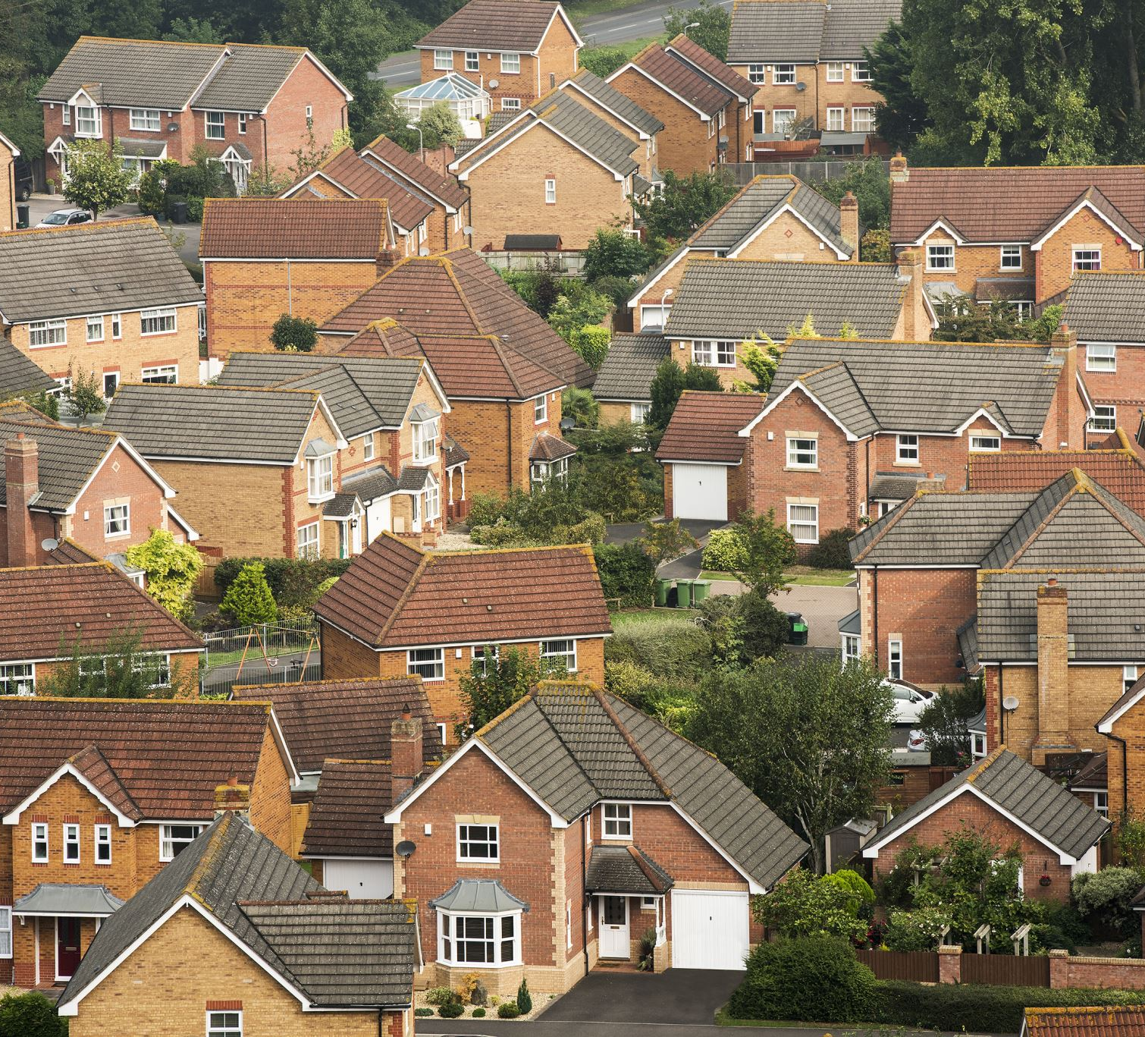
Substandard Housing: refers to any residential structure, unit, or property that, due to its condition or deficiencies, poses a current or potential threat to health, safety, or well-being of its occupants or the public. Substandard conditions are determined based on objective (based on code standards) factors related to the integrity and functionality of the structure and its systems/components (everything within), rather than aesthetic or superficial appearance alone.

Slide 3
Top 5 Priority Solutions
Implement or reinforce minimum habitability standards, especially for heating, ventilation, plumbing, and pest control
1
Streamline reporting: Improve the public’s ability to report substandard conditions anonymously via apps or websites
2
Review and ensure building codes and rental housing ordinances align with current health and safety standards
3
Create a certification or public registry for landlords and property managers that register properties and undergo periodic inspections
4
Create a public awareness campaign regarding substandard housing (“see something, say something,” how and where to report issues, contact information for service providers, videos)
5

Slide 4
Implement or reinforce minimum habitability standards, especially for heating, ventilation, plumbing, and pest control.
What does this look like?
Who are key stakeholders or supportive organizations?
What action items could move this solution forward?
How long would implementation take?

Slide 5
Streamline reporting: Improve the public's ability to report substandard conditions anonymously via apps or website.
What would be helpful?
Commonalities over jurisdictions?
Examples of successful platforms or accessible websites?
Who are the decision makers?
How long would implementation take?

Slide 6
Review and ensure building codes and rental housing ordinances align with current health and safety standards.
Primarily the responsibility of the jurisdictions to work cooperatively to update.
Other thoughts or action items that would help move this forward?

Slide 7
Create a certification or public registry for landlords and property managers that register properties and undergo periodic inspections.
West Lafayette and Lafayette Housing Authority has some data.
What information would be gathered?
What reporting information would be provided to the public?

Slide 8
Create a public awareness campaign regarding substandard housing (“see something, say something,” how and where to report issues, contact information for service providers, videos).
What information?
Who would be the responsible group or entity?
Who would be our target audience?
How would we share the information?
How long would the campaign last?

Slide 9

Next Steps:
- Where do we start?
- Easy wins?
- Action steps before next meeting.

Slide 10
Next Meeting
September 11th 1:00 pm
West Lafayette City Hall

