Slide 1

Tippecanoe Housing Solutions Coalition
Decreasing Substandard Housing Task Force
September 11, 2025

Slide 2
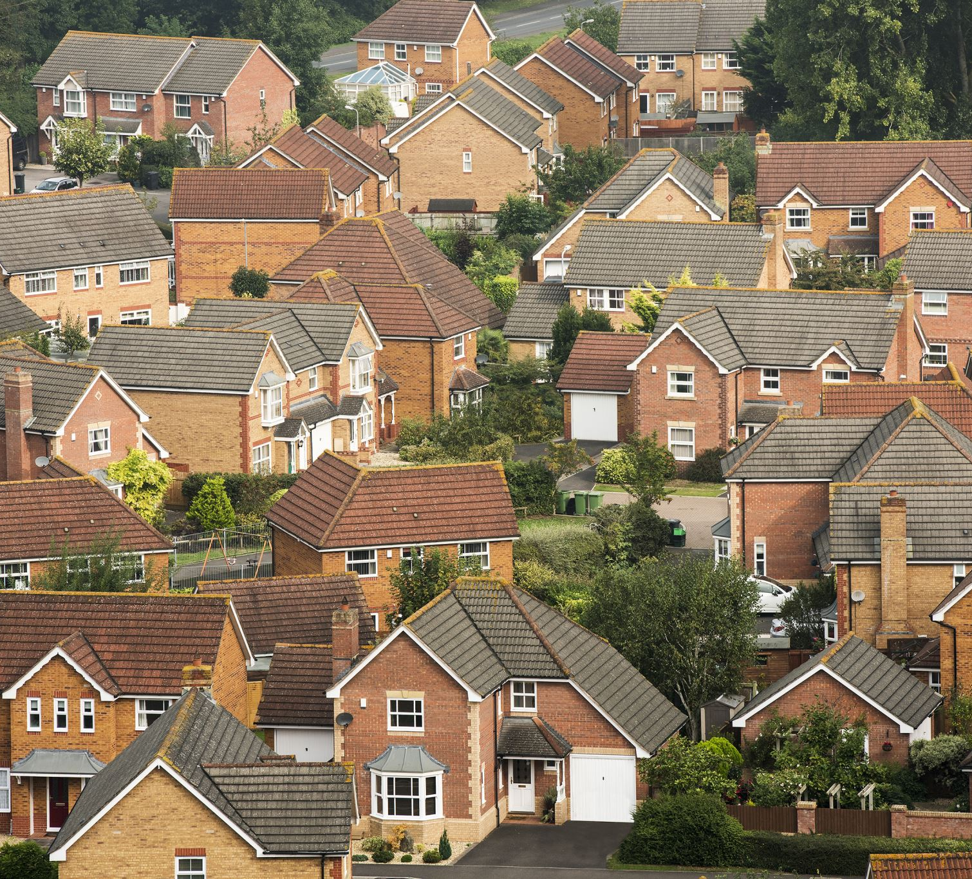
Substandard Housing: Refers to any residential structure, unit, or property that, due to its physical condition or deficiencies, presents a current or potential risk to the health, safety, or general welfare of its occupants or the public. Substandard conditions are identified through objective factors—measured against applicable housing or building codes—relating to the structural integrity, essential systems, and functional components of the property. Determinations are not based solely on aesthetic or cosmetic appearance.

Slide 3
Top 5 Priority Solutions
Reinforce minimum habitability standards - heating, ventilation, plumbing, and pest control.
1
Update and implement local property maintenance ordinances to align with current health and safety standards.
2
Expand and simplify options for the public to report substandard housing conditions and encourage homeowners to seek assistance when issues arise.
3
Establish a public registry to track landlords and property managers highlighting those with recurring or unaddressed deficiencies.
4
Increase public understanding of substandard housing, how to recognize unsafe conditions, and the proper channels for reporting.
5

Slide 4
Reinforce minimum habitability standards - heating, ventilation, plumbing, and pest control.
Legislative Barriers/Advocacy
Advocate for changes to the Unsafe Building Law (UBL):
Shorten compliance timelines.
Increase penalties or provide authority for firmer action against non-compliance.
Reduce 90-day gap before next penalty.
Advocate to expand pest control authority to include bed bugs.
Actions:
Create an internal rapid response protocol for emergency cases.
Develop and implement an internal reporting policy to allow for soft referrals of housing concerns by city and county staff, such as police, fire, code enforcement, or other frontline employees.

Slide 5
Update and implement local property maintenance ordinances to align with current health and safety standards.
Actions:
Short-Term
City of Lafayette adopting updated 2024 IPMC by January 1, 2026.
City of West Lafayette 2018 IPMC will review Lafayette’s ordinance to see if adopting standards would have a significant impact.
City of West Lafayette and Lafayette to meeting with County representation to discuss adopting IPMC.
Launch landlord education sessions on property maintenance code updates – Q1 next year.
Long-Term
Develop cross-jurisdiction agreements for consistent enforcement.

Slide 6
Expand and simplify options for the public to report substandard housing conditions and encourage homeowners to seek assistance when issues arise.
Streamline reporting through improved accessibility, including enhanced website features.
Create easily accessible rental inspection request forms.
Improve website usability by adding a clear map of jurisdictions, reporting pathways, and resource connections.
Build partnerships with repair companies, case workers, law enforcement, fire departments, APS, congregational care teams, and community health workers to serve as advocates and reporters.
Develop standardized processes to guide and coordinate partner involvement.
Provide clear, accessible support to tenants and homeowners, including referrals to resources such as the Bauer Resource Guide, Legal Aid, and APS.

Slide 7
Establish a public registry to track landlords and property managers highlighting those with recurring or unaddressed deficiencies.
What information is valuable?
Short-Term
Publish annual data on complaints, inspections, and enforcement actions.
Long-Term
Create a certification or public registry for landlords and property managers.

Slide 8
Increase public understanding of substandard housing, how to recognize unsafe conditions, and the proper channels for reporting.
Actions:
Develop a comprehensive awareness campaign:
Provide clear guidance on the differences between unsafe and unfit housing, including when and how to report each.
Include accessible materials such as videos, flyers, and community events.
Ensure outreach reaches the right audience at the right time, leveraging community partners for effective distribution.
Targeted outreach campaigns:
Advocacy Lane: Equip social workers, service providers, and community partners with information, tools, and protocols for identifying and reporting issues.
Tenant Campaign: Teach renters to identify unsafe conditions and access reporting tools, emphasizing tenant rights and responsibilities.
Educate tenants and homeowners on what it means to be a good tenant and a responsible member of the community.

Slide 9

Review Next Steps: - Drivers - Actionable steps prior to next meeting

Slide 10
Next Meeting October 9th 1:00 pm West Lafayette City Hall

